Slide 1
Image to Image translation with GAN(Generative Adversarial Network)
Presented by
VIGNESH V
III-YEAR CSE,KVCET
NM ID: au421221104054
EMAIL ID: vvicky2101@gmail.com
3/21/2024 Annual Review

Slide 2
PROJECT TITLE
IMAGE TO IMAGE TRANSLATION WITH GAN
3/21/2024 Annual Review

Slide 3


AGENDA
Introduction
Problem Statement
Project Overview
End Users
Solution and Value Proposition
The WOW in Your Solution
Modeling
Conclusion
3/21/2024 Annual Review

Slide 4

PROBLEM STATEMENT
The challenge in image-to-image translation using GAN models lies in developing a system capable of accurately converting images from one domain to another while preserving important visual features and details. Traditional methods often struggle with maintaining fidelity and consistency across different domains, leading to suboptimal results. The objective is to harness the power of generative adversarial networks (GANs) to create a robust model that can seamlessly translate images between diverse domains, enabling applications such as colorization, style transfer, and image enhancement with high accuracy and efficiency.
3/21/2024 Annual Review

Slide 5
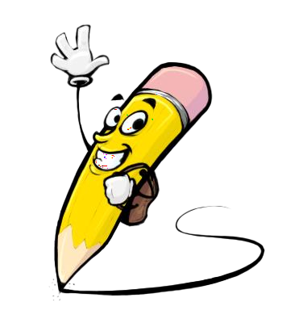
PROJECT OVERVIEW
The project aims to develop an image-to-image translation model based on generative adversarial networks (GANs). This involves designing a robust architecture capable of accurately transforming images from one domain to another, such as grayscale to color, low-resolution to high-resolution, or sketch to photograph. The key components include data collection, GAN architecture design, training, evaluation, and deployment. By leveraging GANs, the system will enable precise and efficient translation across various image domains, empowering users in fields such as graphic design, photography, medical imaging, and augmented reality with versatile and powerful image processing capabilities.
3/21/2024 Annual Review

Slide 6

WHO ARE THE END USERS?
Graphic Designers: Enhance image editing and manipulation workflows.
Photographers: Colorize black and white photos or enhance images.
Medical Imaging Professionals: Improve image quality and analysis.
Augmented Reality Developers: Generate realistic textures and scenes.
3/21/2024 Annual Review

Slide 7

YOUR SOLUTION AND ITS VALUE PROPOSITION
Solution: AI generator accurately translates images between domains.
Value Proposition:
Precise translation for various applications.
Enhance creativity and efficiency in image processing.
Unlock new possibilities in visual content generation.
3/21/2024 Annual Review

Slide 8

THE WOW IN YOUR SOLUTION
Accuracy: Achieve precise translation between diverse image domains.
Flexibility: Handle various image translation tasks with ease.
Efficiency: Speed up image processing workflows with AI automation.
Versatility: Deploy solution across different industries and use cases.
3/21/2024 Annual Review

Slide 9
MODELLING
Data Preprocessing: Prepare paired images for training.
GAN Architecture: Design generator and discriminator networks.
Training: Optimize model parameters for accurate translation.
Evaluation Metrics: Assess quality and fidelity of translated images.
3/21/2024 Annual Review

Slide 10
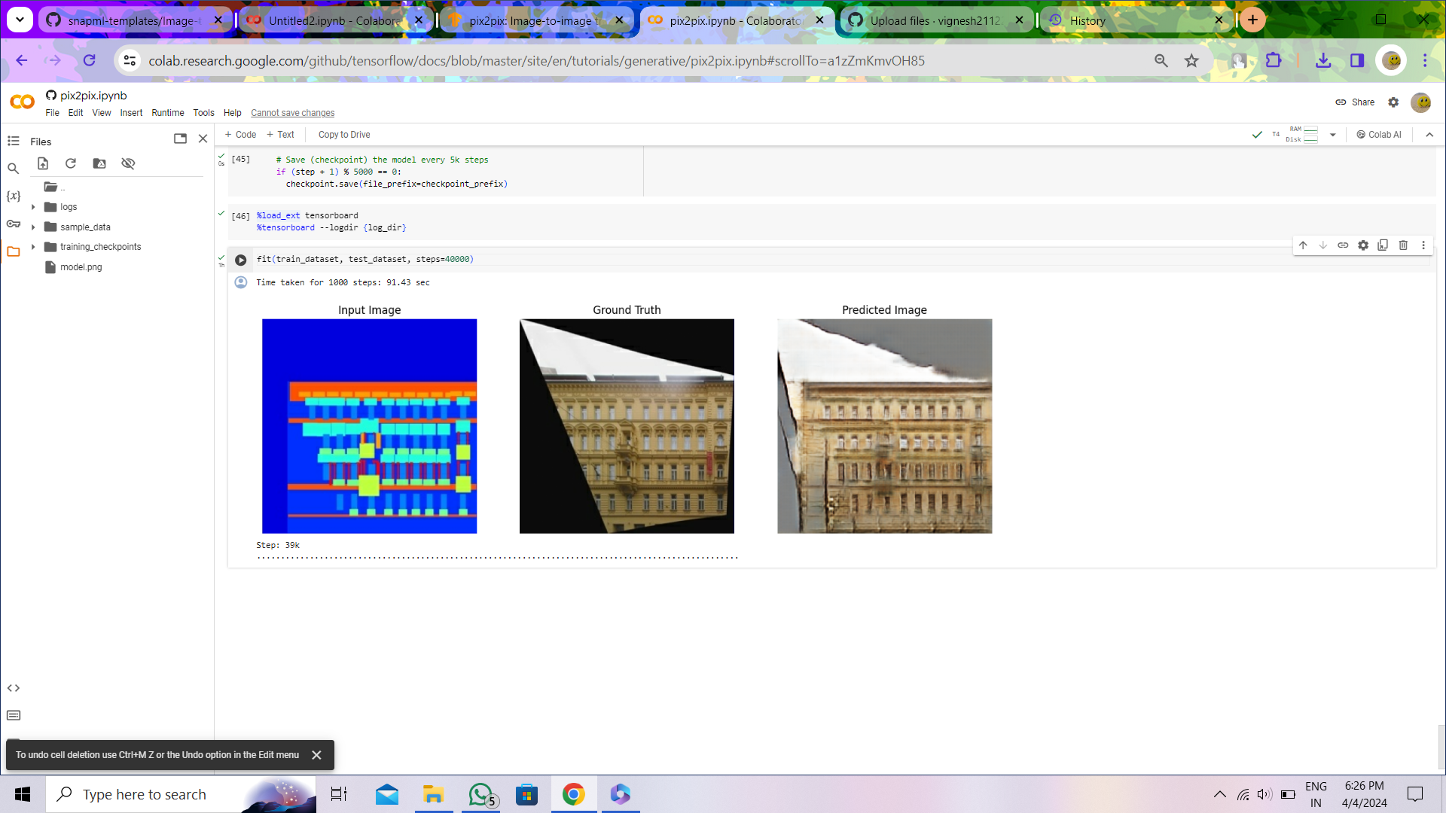
RESULTS
https://colab.research.google.com/drive/14Nd3Zwx7nuAsTYT7JSJxiY9r_S_6Efle

Slide 11
CONCLUSION
In conclusion, the development of an image-to-image translation model using generative adversarial networks (GANs) offers a transformative solution to various image processing tasks. By accurately translating images between different domains while preserving essential features, this model enhances creativity and efficiency across numerous fields.
The project's success in designing a robust architecture, training it effectively, and validating its performance underscores its potential for real-world applications in graphic design, photography, medical imaging, and augmented reality. With its versatility and precision, the image-to-image GAN model opens new avenues for visual content creation and manipulation, empowering users with advanced tools for image transformation and enhancement.

